Slide 1
Internet of things
The Internet of Things (IoT) refers to a system of interrelated, internet-connected objects that are able to collect and transfer data over a wireless network without human intervention. The personal or business possibilities are endless.
In short, the Internet of Things refers to the rapidly growing network of connected objects that are able to collect and exchange data using embedded sensors. Thermostats, cars, lights, refrigerators, and more appliances can all be connected to the IoT.
An IoT system consists of sensors/devices which “talk” to the cloud through some kind of connectivity. Once the data gets to the cloud, software processes it and then might decide to perform an action, such as sending an alert or automatically adjusting the sensors/devices without the need for the user.
The IoT provides a platform that creates opportunities for people to connect these devices and control them with big data technology ( may not sample but simply observe and track what happens), which in return will promote efficiency in performance, economic benefits and minimize the need for human involvement. It's the most important development of the 21st century.

Slide 2
Explanation

Slide 3
Quick quiz (Poll)
IOT Perspectiveis are defined as
Human to Human
Human to Thing
Thing to Thing
All of above

Slide 4
Agriculture
Smart farms are a fact. The quality of soil is crucial to produce good crops, and the Internet of Things offers farmers the possibility to access detailed knowledge and valuable information of their soil condition.
Through the implementation of IoT sensors, a significant amount of data can be obtained on the state and stages of the soil. Information such as soil moisture, level of acidity, the presence of certain nutrients, temperature and many other chemical characteristics, helps farmers control irrigation, make water use more efficient, specify the best times to start sowing, and even discover the presence of diseases in plants and soil.

Slide 5
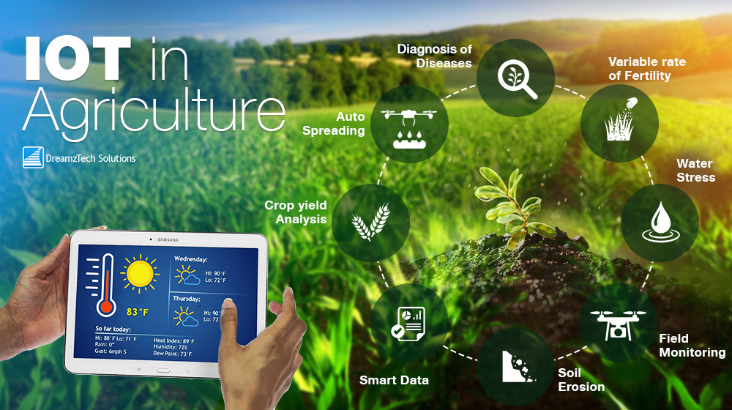
Agriculture

Slide 6
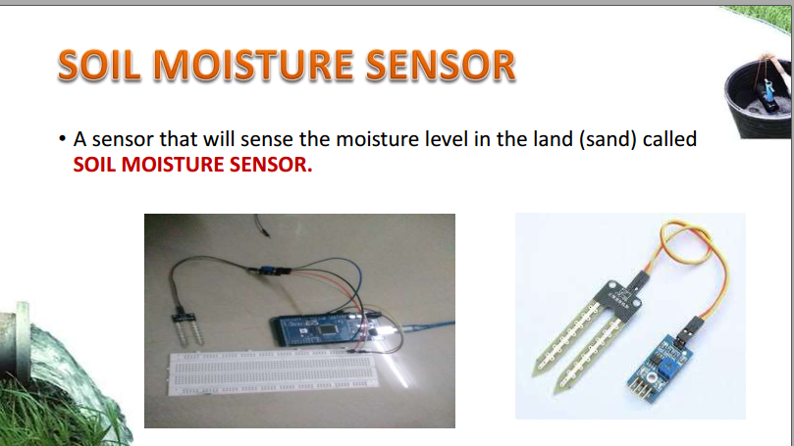
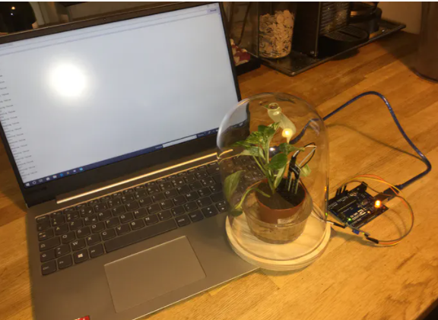
Application:
soil moisture
The electrical resistance is measured between the two electrodes of the sensor. A comparator activates a digital output when a adjustable threshold is exceeded.
Extended part use actuator for action

Slide 7
Quick quiz (Poll)
Which out of following is used to collect and process the data to detect the changes in the physical status of things?
A. Nano Technology
B. Actuators
C. Sensors
D. RFIDs

Slide 8
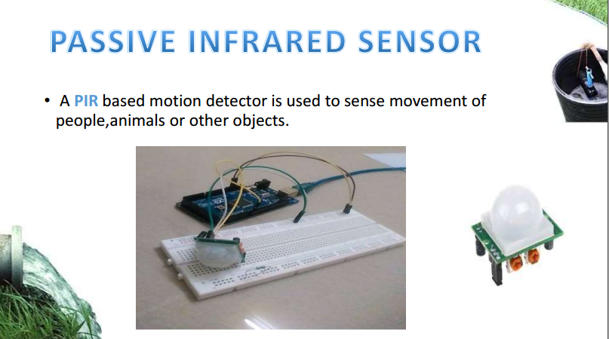
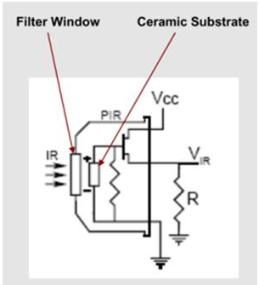
A passive infrared sensor (PIR sensor) is an electronic sensor that measures infrared (IR) light radiating from objects in its field of view. They are most often used in PIR-based motion detectors. PIR sensors are commonly used in security alarms and automatic lighting applications. PIR sensors detect general movement, but do not give information on who or what moved
1. Automatic Door opening System
2. Animal Movement
https://www.elprocus.com/pir-sensor-basics-applications/

Slide 9
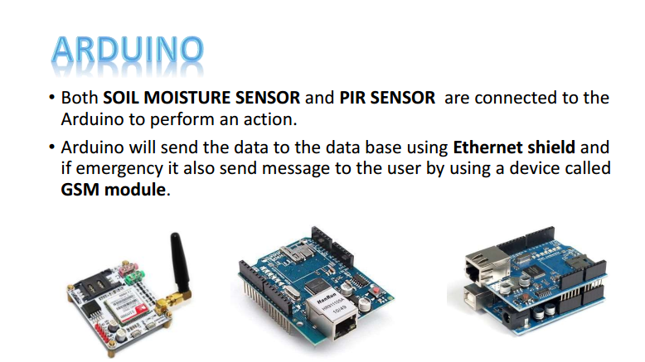

Slide 10
Challenges Faced by Farmers in adopting IoT for Agriculture
1. Lack of Infrastructure: Even if the farmers adopt IoT technology they won’t be able to take benefit of this technology due to poor communication infrastructure. Farms are located in remote areas and are far from access to the internet. A farmer needs to have access to crop data reliably at any time from any location, so connection issues would cause an advanced monitoring system to be useless.
2. High Cost: Equipment needed to implement IoT in agriculture is expensive. However sensors are the least expensive component, yet outfitting all of the farmers’ fields to be with them would cost more than a thousand dollars. Automated machinery cost more than manually operated machinery as they include cost for farm management software and cloud access to record data. To earn higher profits, it is significant for farmers to invest in these technologies however it would be difficult for them to make the initial investment to set up IoT technology at their farms.
3. Lack of Security: Since IoT devices interact with older equipment they have access to the internet connection, there is no guarantee that they would be able to access drone mapping data or sensor readouts by taking benefit of public connection. An enormous amount of data is collected by IoT agricultural systems which is difficult to protect. Someone can have unauthorized access IoT providers database and could steal and manipulate the data.

Slide 11
QUICK QUIZ (POLL)
Identify the actuator in a Smart Agriculture system?
PIR sensor
GSM module
Motor
Temperature sensor

Slide 12
Health
The use of wearables or sensors connected to patients, allows doctors to monitor a patient's condition outside the hospital and in real-time. Through continuously monitoring certain metrics and automatic alerts on their vital signs, the Internet of Things helps to improve the care for patients and the prevention of lethal events in high-risk patients.
Another use is the integration of IoT technology into hospital beds, giving way to smart beds, equipped with special sensors to observe vital signs, blood pressure, oximeter (measure oxygen levels in the blood.) and body temperature, among others.
Smart pills: Technology has an important role to play on this area potentially, with digital gadgets prepared with reminder functionality. An android application is carried out to expose tablet’s every day agenda and pill taking notifications. It relieves the user of the mistake-prone obligations of administering wrong medication at incorrect time.

Slide 13
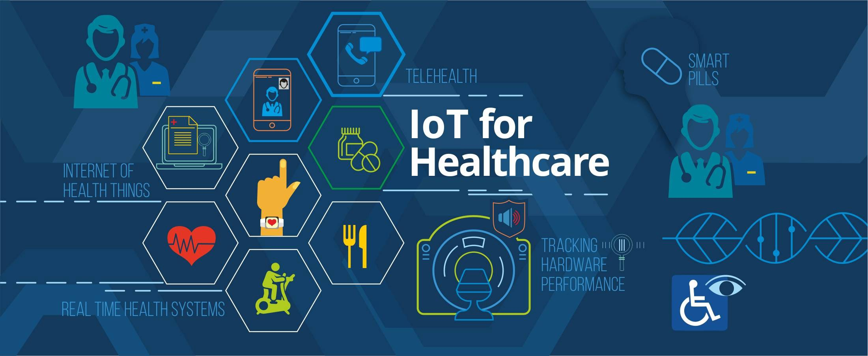
Health
https://youtu.be/6OxiD91PYXo

Slide 14
Smart grid and energy saving
The progressive use of intelligent energy meters, or meters equipped with sensors, and the installation of sensors in different strategic points that go from the production plants to the different distribution points, allows better monitoring and control of the electrical network.
IoT can be used in customer side in smart meters to measure different types of parameters, intelligent power consumption, interoperability between different networks, charging and discharging of electric vehicles, manage energy efficiency and power demand.
By establishing a bidirectional communication between the service provider company and the end user, information of enormous value can be obtained for the detection of faults, decision making and repair thereof.
It also allows offering valuable information to the end user about their consumption patterns and about the best ways to reduce or adjust their energy expenditure.

Slide 15
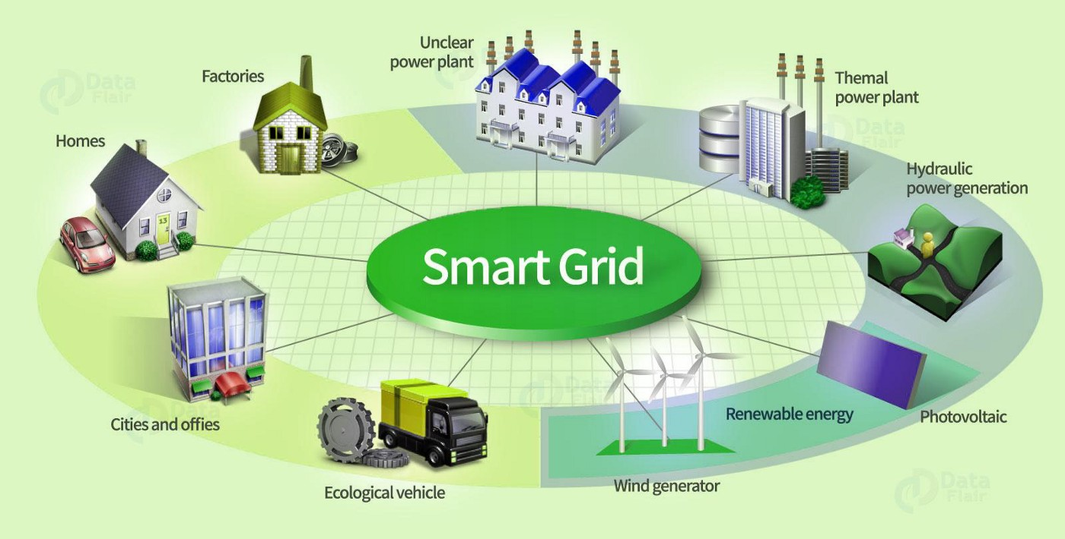
Smart grid and energy saving
Management of electricity done By IOT
https://www.youtube.com/watch?v=4L31dHXP6i0
https://youtu.be/4L31dHXP6i0

Slide 16
IoT in Automobiles
IoT infused semi-autonomous cars take on-spot decisions while partly controlling the vehicle operations to avoid accidents and reduce the load from the driver.
Along with different proximity sensors and cameras, cars are integrated with IoT systems to reduce human error and make driving more comfortable and safe.
https://youtu.be/LRrMDf-2iqE

Slide 17
Quick Quiz Poll
IoT devices can easily lead to catastrophe without ...............
Software
Devices
Cloud
Management system

Slide 18
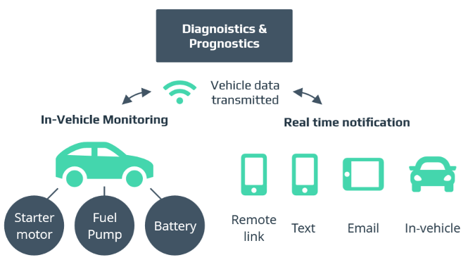
IoT in Automobiles

Slide 19
IoT in Manufacturing
Industrial Internet of Things (IIoT) is a way to digital transformation in manufacturing. Industrial IoT employs a network of sensors to collect critical production data and uses cloud software to turn this data into valuable insights about the efficiency of the manufacturing operations.
In March 2016, BI Intelligence estimated that global manufacturers will invest $70 billion on IoT solutions in 2020 (in 2015 they invested $29 billion, the report says).
In the US, for instance, IoT spend by the manufacturing industry will account for approximately 15 percent of total IoT purchases.
The manufacturing industry is leading in the Internet of Things for various reasons: some are historical, others are related with the so-called next industrial revolution (Industry 4.0)

Slide 20
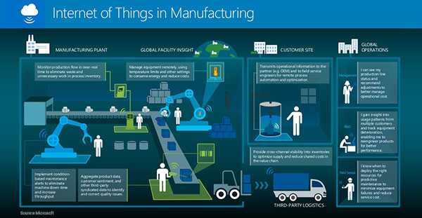
IoT in Manufacturing
Home automation :
https://youtu.be/rlWVYBR-W54
https://youtu.be/R5RfSQ3Nxzg

Slide 21
Explanation
As you can see it distinguishes between the manufacturing plant, global facility insight (beyond the factory), the customer site and global operations with the latter being divided into the goals and benefits for management, R&D and field service.
It also shows some additional or, let’s say, more detailed use cases and the benefits they offer, including:
Production flow monitoring: optimize flow, eliminate waste and avoid unnecessary work in process inventory.
Remote equipment management, including setting specific limits and parameters to save energy and costs.
Condition-based maintenance alerts: optimize machine availability, minimize interruption and increase throughput.
An important one: the usage of various data (product, customer sentiment and more) as a driver of quality monitoring and enhancement in function of outcomes and this aggregated data.
Outside of the plant and actual manufacturing environment (insights and production) we see the transmission of operational information for those field service engineers on customer sites, the overall value and supply chain perspective, third-party logistics and the global operations dimension.

Slide 22
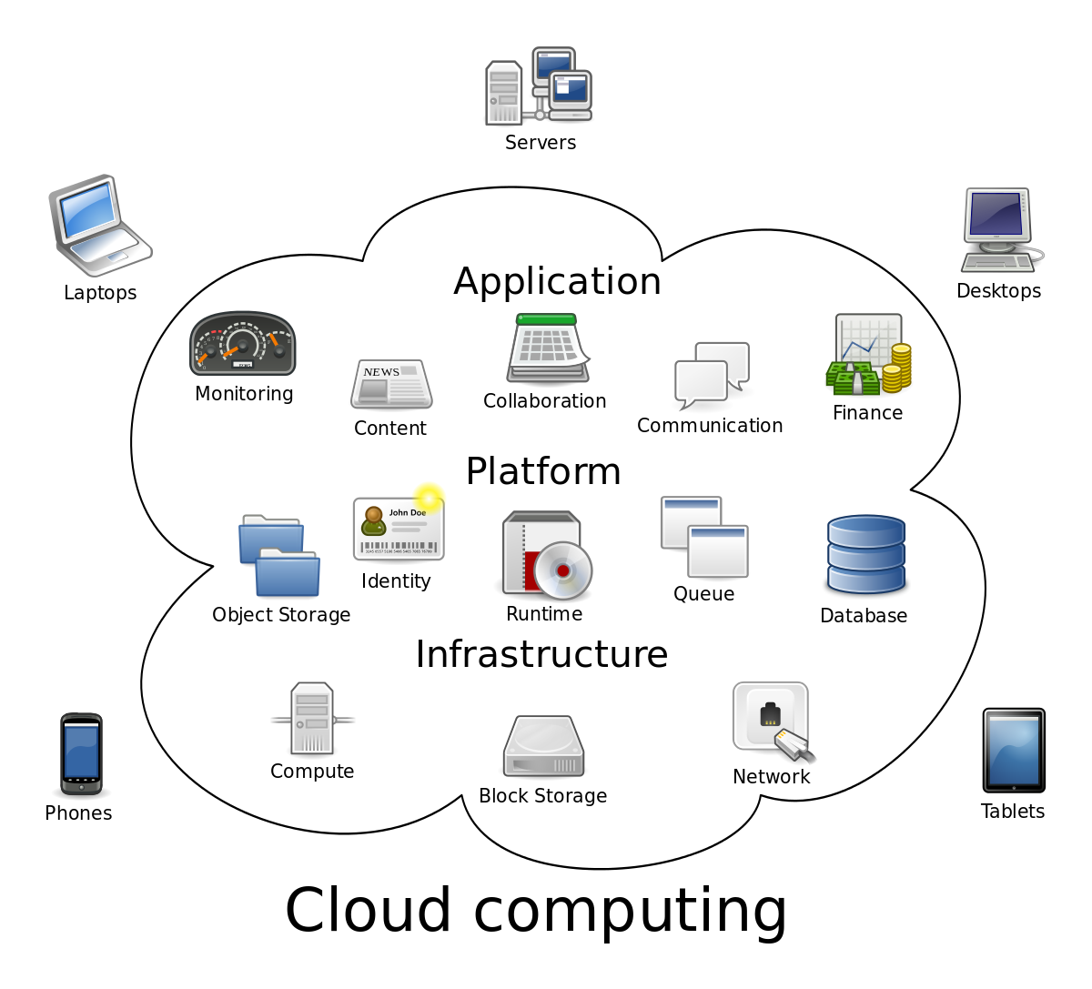

Slide 23
Cloud Computing
Cloud Computing is the use of hardware and software to deliver a service over a network (typically the Internet). With cloud computing, users can access files and use applications from any device that can access the Internet.
An example of a Cloud Computing provider is Google's Gmail. Gmail users can access files and applications hosted by Google via the internet from any device.
How is computing from the Cloud different from computing from my PC's hard drive?
Unlike traditional computing where data is stored on your PC's local hard drive, the data in the cloud is stored on many physical and/or virtual servers that are hosted by a third-party service provider. An example of a cloud computing file storage provider is Dropbox. Dropbox files can be accessed from any device via the Internet.

Slide 24
Cloud Computing
Simply put, cloud computing is the delivery of computing services—including servers, storage, databases, networking, software, analytics, and intelligence—over the Internet (“the cloud”) to offer faster innovation, flexible resources, and economies of scale.
Cloud computing is the on-demand availability of computer system resources, especially data storage (cloud storage) and computing power, without direct active management by the user. The term is generally used to describe data centers available to many users over the Internet.
A simple definition of cloud computing involves delivering different types of services over the Internet. ... You can access it from just about any computer that has internet access. For businesses, cloud computing means improved collaboration and productivity, as well as significant cost reductions.

Slide 25
Quick quiz Poll
MQTT and HPTT are the protocols
A)Machine to machine interaction
B)Internet of things interaction
C)Cloud computing
D)Any of the above
MQTT is a lightweight protocol that runs on top of the TCP/IP protocol and works with publish subscribe mechanism. he MQTT protocol is a machine to machine and Internet of thing connectivity protocol.

Slide 26
Quick quiz Poll
The ____________ allows systems and services to be accessible by a group of organizations.
A. Private cloud B. Public cloud C. Community cloud D. Hybrid cloud

Slide 27
Quick quiz Poll
Which of the following is true about cloud computing?
A. Cloud computing is platform dependent B. Cloud Computing makes our business applications mobile and collaborative. C. Cloud Computing provides us means of accessing the applications as utilities over computer only. D. All of the above

Slide 28
Quick quiz Poll
The term ______ refers to a Network or Internet.
A. Cloud Computing B. Cloud C. Computing D. CRM
Cloud Computing refers to manipulating, configuring, and accessing the hardware and software resources remotely. It offers online data storage, infrastructure, and application

Slide 29
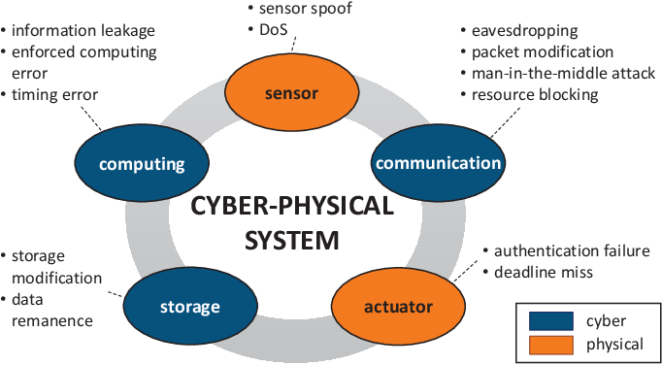
Cyber Physical Systems

Slide 30
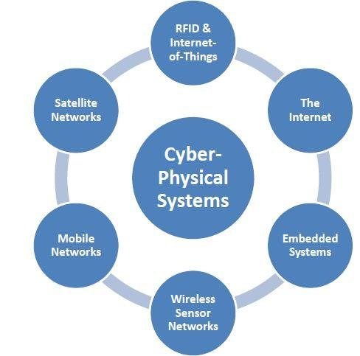
Cyber Physical Systems
A cyberphysical system is a computer system in which a mechanism is controlled or monitored by computer-based algorithms
Cyber-Physical Systems (CPS) are integrations of computation, networking, and physical processes. Embedded computers and networks monitor and control the physical processes, with feedback loops where physical processes affect computations and vice versa.
Cyber-Physical System (CPS), a new generation of digital system, mainly focuses on complex interdependencies and integration between cyberspace and physical world
A CPS is composed of highly-integrated computation, communication, control, and physical elements.

